Slide 1
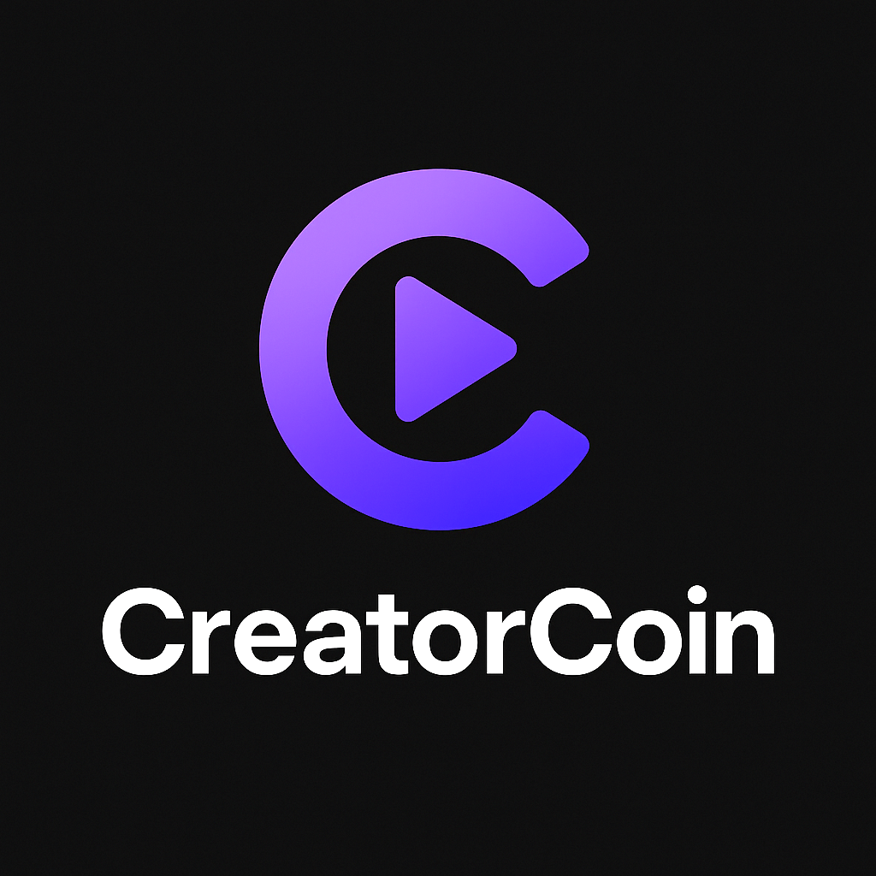
Creator Token Web3 Platform
Empowering Creators with Blockchain
Year

Slide 2
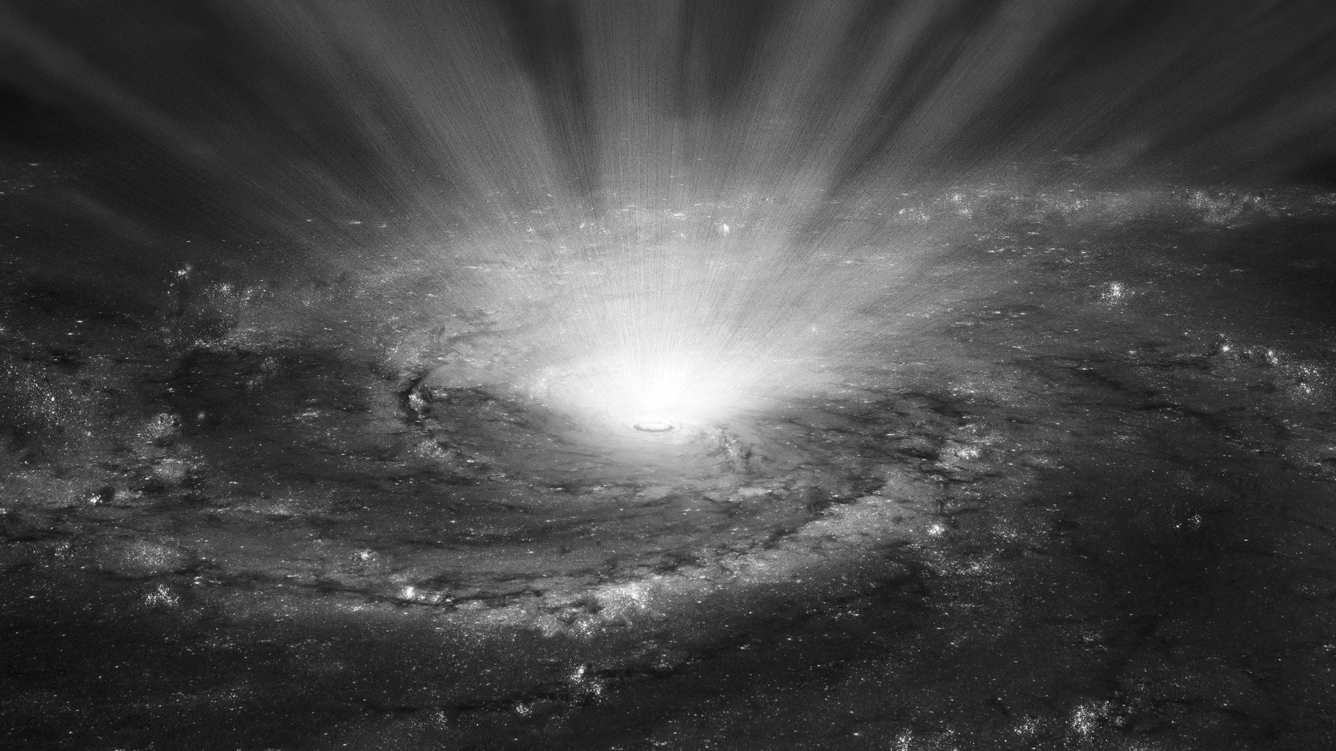
Empower every event with seamless tech-driven experiences.Together, we can amplify reach, boost engagement and create moments
Our mission

Slide 3



Creators earn less due to high platform cuts
Limited fan engagement
Revenue depends on algorithms
No true ownership of community

Slide 4
What we do
Launch your own token Create a custom digital asset for your community or brand.
Reward loyal fans
Offer tokens as rewards for engagement and support.
Unlock gated content
Give token holders exclusive access to premium content.
Company Name
Quarter Month
Year

Slide 5
How the partnership will work
1
2
3
4
5
Creator Launches Token
Fans Purchase Tokens
Reward Loyalty
Unlock Gated Content
Grow & Trade
Fans can trade tokens or hold them as your brand’s value grows
Easily create and deploy your own branded token.
Supporters buy tokens to join your community.
Add another example. Think about how you’ll manage check-ins and reviews.
Give token-holders access to exclusive posts, videos, or perks.
Year

Slide 6
Market Opportunity
1
2
3
50M+ global creators
A massive audience ready to tokenize their influence.
$250B creator economy by 2030
A massive audience ready to tokenize their influence.
Rising Web3 adoption
A massive audience ready to tokenize their influence.
Company Name
Quarter Month
Year

Slide 7
Revenue Streams
1
2
3
% fee on secondary trades
Premium creator features
% fee on token sales
Offer paid tools and analytics for power creators.
Earn commission whenever creators launch and sell their tokens.
Capture value from ongoing peer-to-peer token trading.
Company Name
Quarter Month
Year

